Slide 1

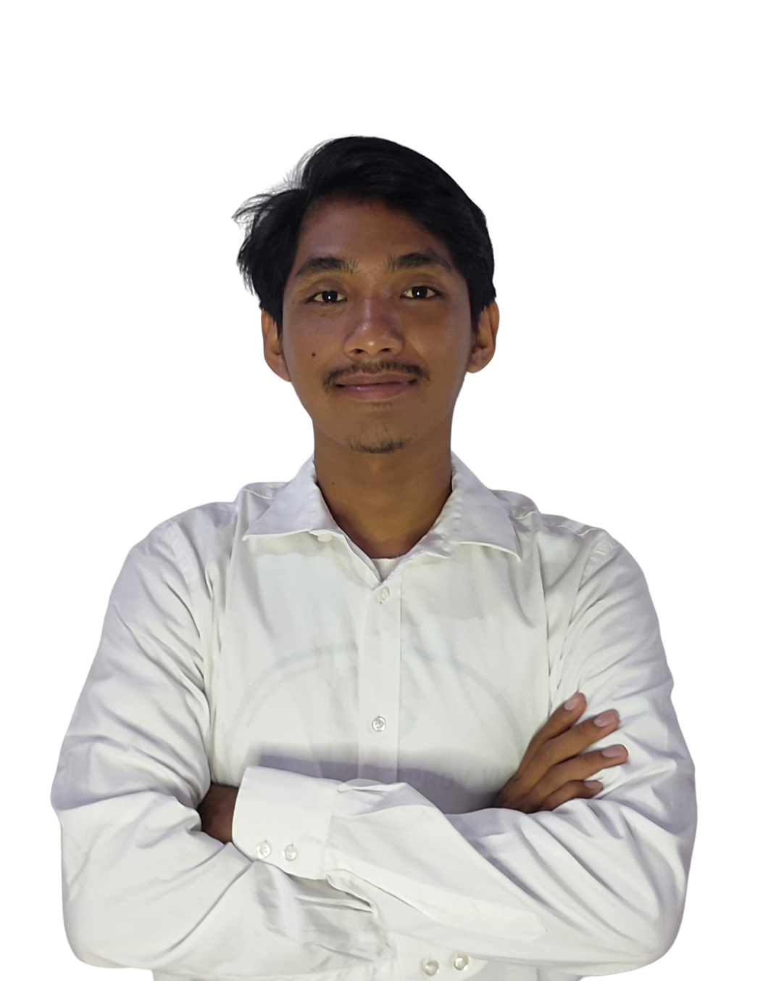
KOTA BEKASI, JAWA BARAT
BACKEND DEVELOPER
PORTFOLIO
Francois Novalentino S
novalsinurat28@gmail.com
francois-porto.vercel.app

Slide 2
ABOUT ME
Hello, I'm Noval. Informatics Engineering graduate from Institut Teknologi Sumatera with 2+ years of hands-on experience in backend and full stack web development. Skilled in building scalable web applications, RESTful APIs, system integrations, and cloud-based deployments using Golang, Node.js, PHP, Python, Next.js, and React.js. Experienced in developing financial and enterprise systems with PostgreSQL, MySQL, Redis, RabbitMQ, and Google Cloud Platform (GCP). Strong adaptability, problem-solving skills, and proven experience working in both collaborative teams and production environments.

Slide 3
EDUCATION
ORGANIZATION
Institut Teknologi Sumatera
(2021 - 2025)
Himpunan Mahasiswa Informatika ITERA
(2023 - 2024)
Bachelor of Informatics Engineering
GPA: 3.33 / 4.00
Thesis: Development of a Recommendation System for Massive Open Online Courses Using Hybrid Filtering
Built a MOOC recommendation web app using hybrid ML models with Next.js, FastAPI, and GCP
  Head of Operations Division for the Informatics Student Association Members' Assembly (2023)
  Event Coordinator for the Christmas Celebration (2023)
  Operational Staff for the Inauguration Event (2023)
  Operational Staff for the Leadership, Ethics, and Organizational Management Training (LKEMO) (2023)
  Operational Staff for the First Gathering (2022)
SMAN 8 Bekasi
IPA
GPA: 87.50/100

Slide 4


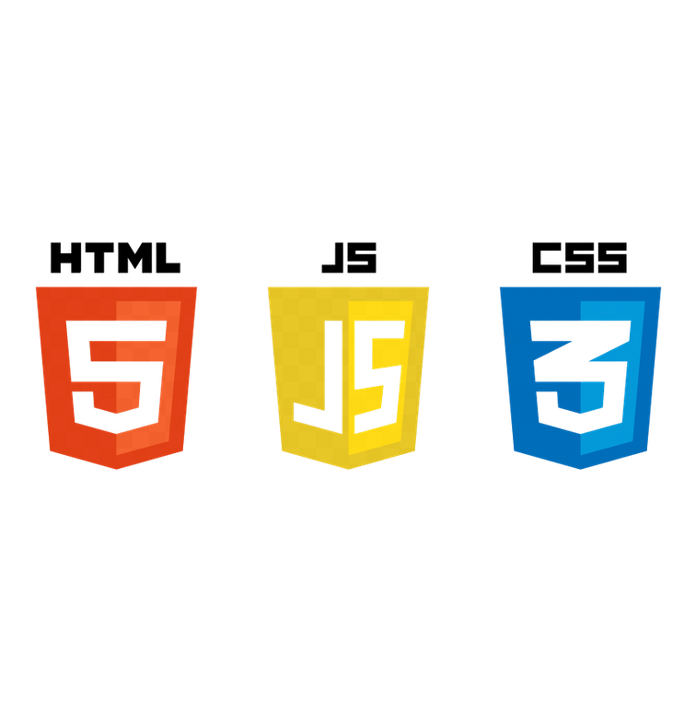


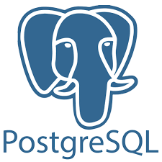



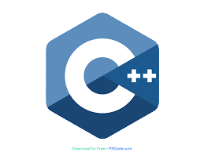


PERSONAL SKILLS
HTML
JS
CSS
Python
Golang
C++
Next.js
React.js
Node.js

Slide 5
WORK EXPERIENCE
BACKEND DEVELOPER
PT Neekosa Pakar Services (Client: PT Pegadaian)
July 2026 -
Present
  Develop and maintain Golang microservices for Pegadaian Gadai Syariah Rahn with TEFS Titipan from loan submission through disbursal.
  Build end-to-end Rahn and TEFS Titipan conversion across submission, approval, confirmation, and disbursement services.
  Maintain multi-stage workflow orchestration and service integrations using OpenAPI and Swagger.
  Create Kafka Control Center connectors to consume and sync data from DB2 to PostgreSQL via API.
  Support production delivery on Pegadaian SPRINT including API testing and UAT with Postman.
BACKEND DEVELOPER
PT Teknologi Operator Prima
August 2025 -
July 2026
  Developed Mobile Banking backend services using Golang, handling core business logic and high-performance APIs.
  Optimized MySQL queries and improved performance through indexing and query tuning.
  Integrated external systems via SFTP and managed transactional data using PostgreSQL.
Developed Gateway Service using Golang for payment gateway, third-party APIs, and internal microservices.
Implemented Redis for caching and RabbitMQ for asynchronous messaging.
Maintained Digital Banking applications using Delphi and developed ERP modules using PHP with MongoDB.
Performed API testing and UAT using Postman.

Slide 6
WORK EXPERIENCE
CLOUD COMPUTING
February - July
2024
Bangkit Academy by Google, Tokopedia, Gojek, and Traveloka
  Utilized Google Cloud Platform for cloud-based project development.
  Collaborated on a capstone project using Next.js, Node.js, and Cloud SQL.
  Deployed the application on Google Cloud Run for scalable delivery.
FULL STACK DEVELOPER INTERN
June - August
2024
Dinas Cipta Karya Tata Ruang dan Pertanahan Provinsi DKI Jakarta
  Implemented essential features like Asset Groups using Laravel Framework for efficient asset categorization and management.
  Developed and integrated the AssetGroup Model with Laravel Eloquent ORM for effective data storage and management.
  Adopted the MVC architecture in Laravel to enhance system modularity, maintainability, and performance.

Slide 7
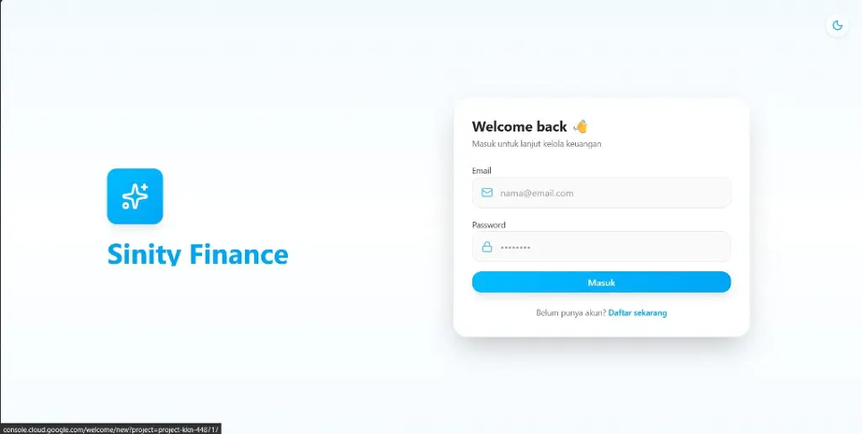
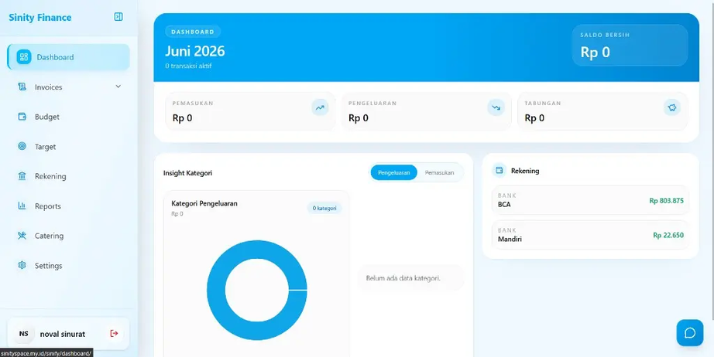


PROJECTS
Sinity Finance
Personal finance management web app for tracking income, expenses, budgeting, savings, and account balances with mock/demo mode.
Responsibilities:
  Built a responsive modern dashboard using Next.js and ShadCN UI.
  Developed backend services using Golang for financial data management.
  Implemented mock/demo mode that allows users to explore without real financial data.
  Deployed on Vercel for fast and reliable hosting.
Reach Out

Slide 8
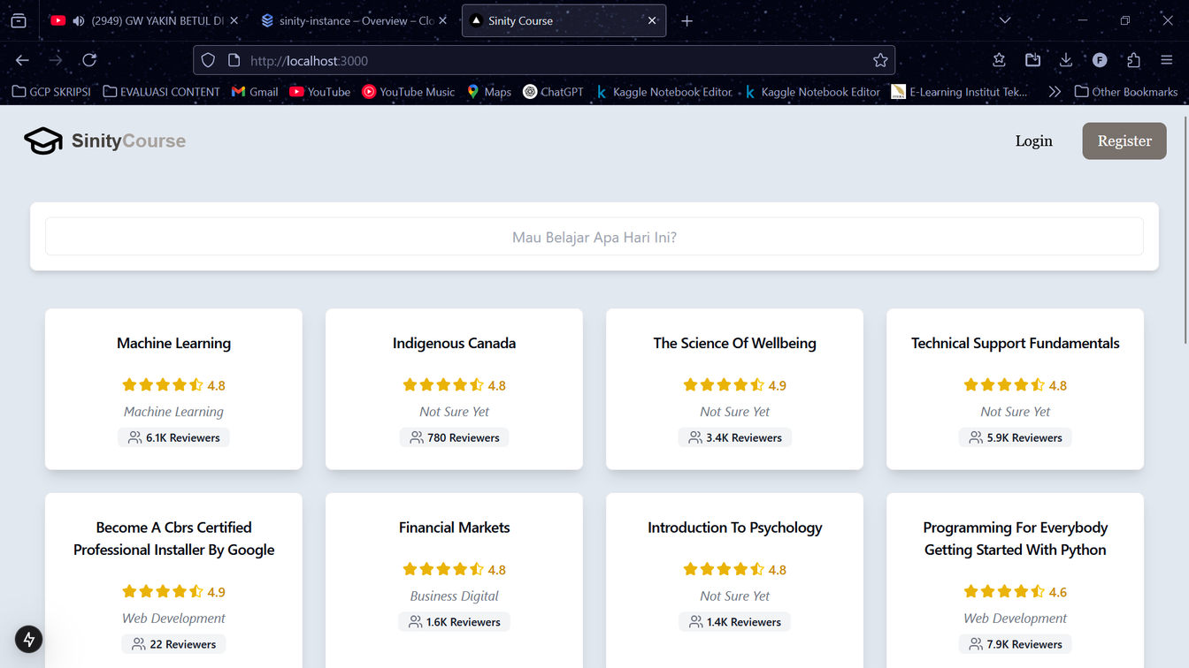
PROJECTS
Sinity Course
Final thesis project at Institut Teknologi Sumatera. Built a MOOC recommendation web app using hybrid machine learning models that combine content-based and collaborative filtering.
Responsibilities:
  Developed a responsive frontend using Next.js, Tailwind CSS, and ShadCN UI.
  Implemented recommendation API and hybrid ML models using FastAPI.
  Integrated PostgreSQL as the primary relational database.
  Deployed on Google Cloud Platform using Cloud Run.
Reach Out

Slide 9
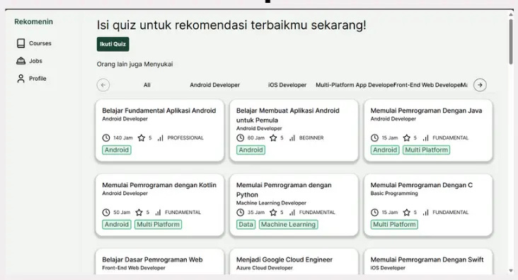
PROJECTS
Rekomenin Web
Capstone project for Bangkit Academy 2024 led by Google, GoTo, Traveloka, and Tokopedia. Recommendation platform for courses and jobs on Dicoding.
Responsibilities:
  Developed a responsive frontend web interface using Next.js.
  Integrated frontend services with backend APIs.
  Managed cloud deployment on Google Cloud Platform.
  Deployed using Google Cloud Run.
Reach Out

Slide 10
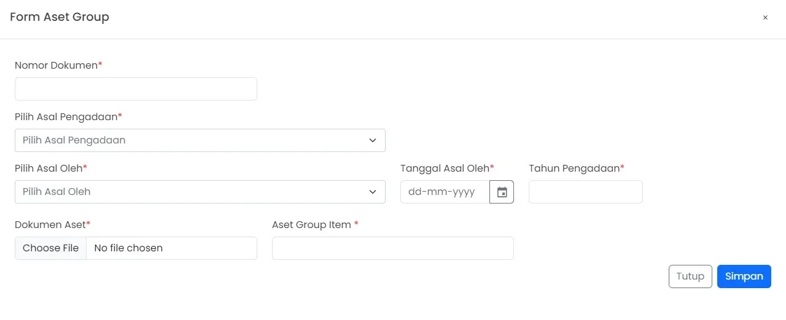
PROJECTS
Asset Management System
Developed a web-based asset management system as a Full Stack Developer Intern at Dinas Cipta Karya Tata Ruang dan Pertanahan Provinsi DKI Jakarta.
Responsibilities:
  Implemented the Asset Group feature with CRUD functionality using Laravel's MVC architecture.
  Integrated role-based access control to manage user permissions securely.
  Utilized Laravel, MySQL, and Bootstrap for a structured and responsive asset management system.
Reach Out

Slide 11
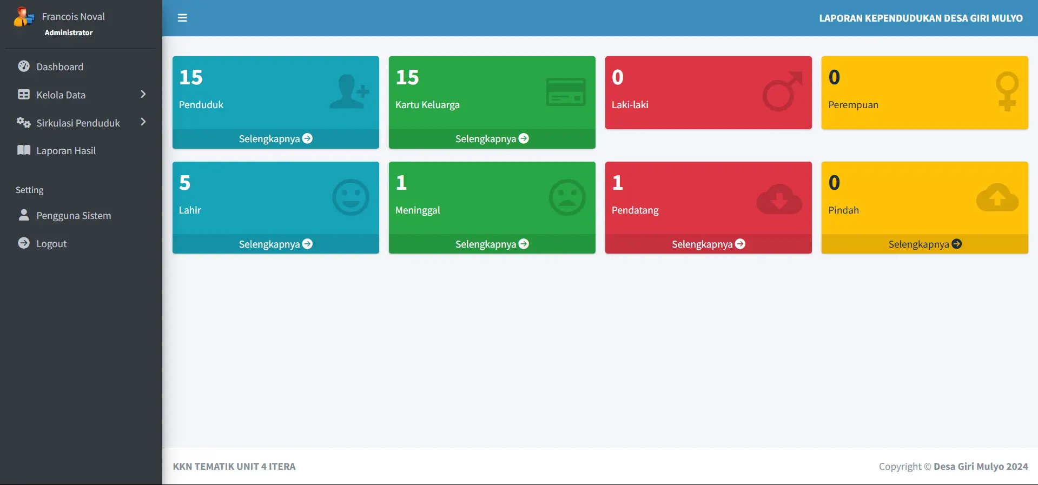
PROJECTS
Population Report
Girimulyo Village
Developed a web-based system for managing village population circulation.
Responsibilities:
  Implemented secure login system.
  Developed frontend using PHP Native.
  Designed responsive UI with Bootstrap.
  Managed structured data storage with SQL.
Reach Out

Slide 12
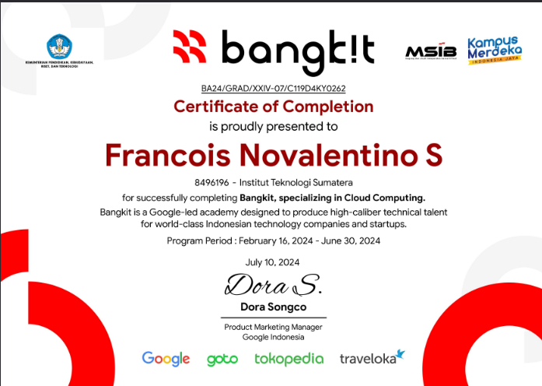
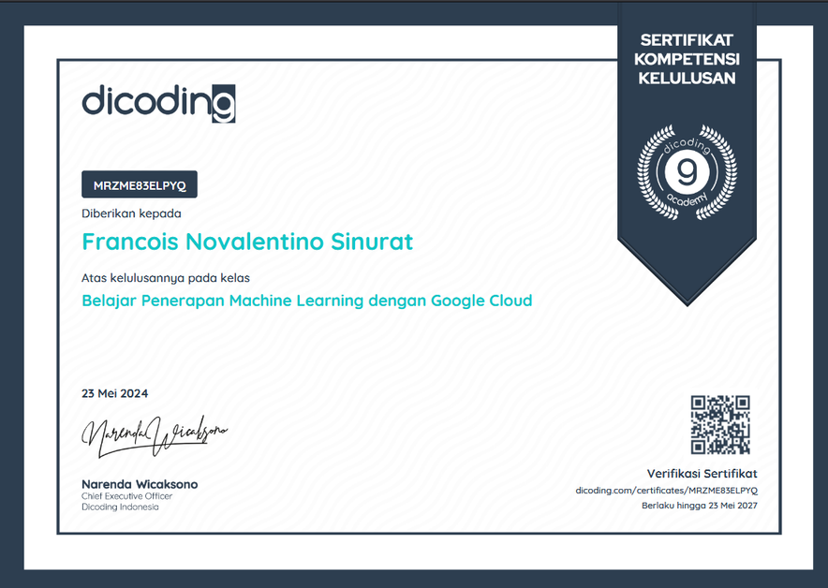
CERTIFICATE
Bangkit Academy Graduated
Apply Machine Learning with Google Cloud

Slide 13
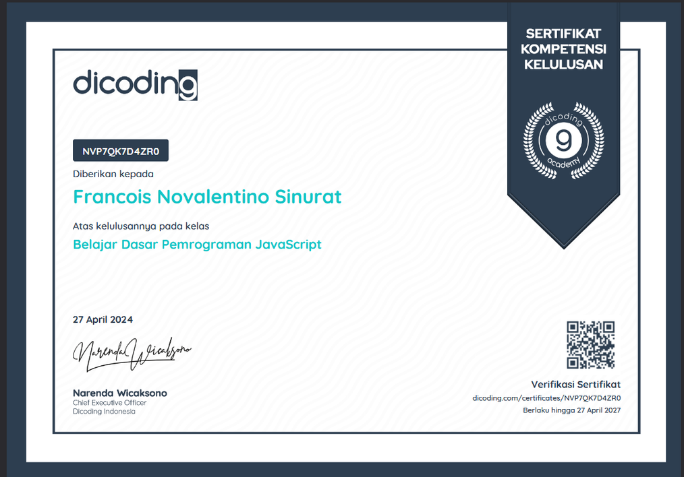

CERTIFICATE
JavaScript Programming Basics
Web Programming Basics

Slide 14
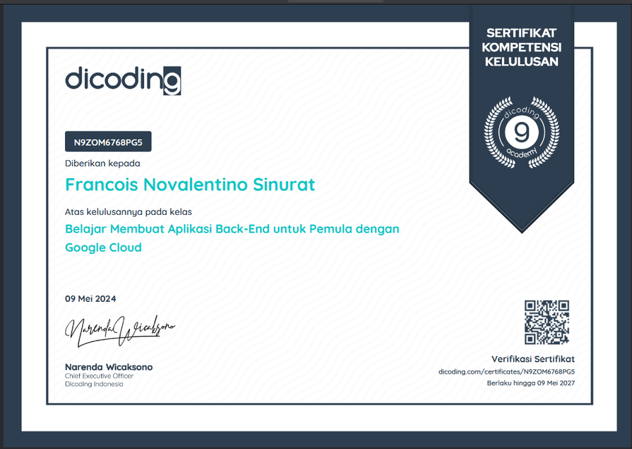
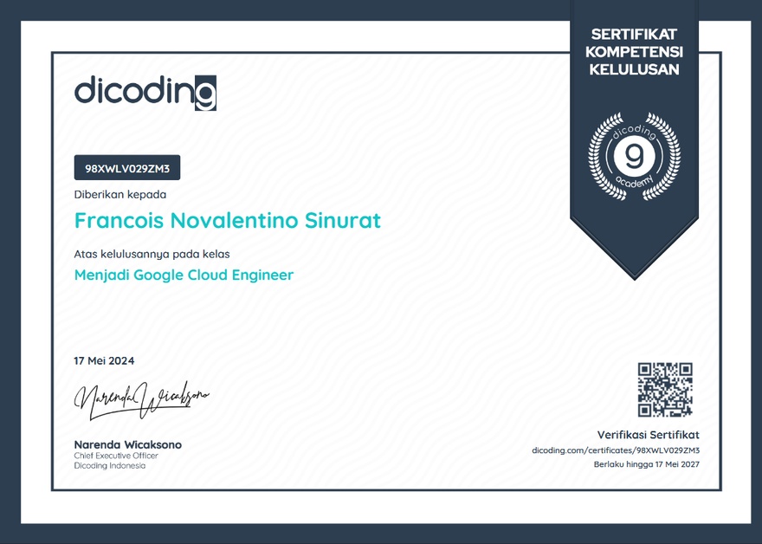
CERTIFICATE
Create Back-End Applications for Beginners with Google Cloud
Become a Google Cloud Engineer

Slide 15




REACH ME
LINKEDIN
GMAIL
GITHUB
GITLAB

Slide 16
THANK YOU
Let’s Collaborate!

